Slide 1

Traffic Detection and Tracking System Using YOLOv8
Presented By : Saras Umakant Pantulwar
20CS30046
IIT Kharagpur | 2025

Slide 2
Project Overview
1
Objective:
Develop a system for detecting and tracking vehicles in traffic videos
Capabilities:
Detect multiple vehicle types (cars, trucks, buses, motorcycles)
Track unique vehicles across frames
Classify direction (incoming/outgoing)
Generate traffic statistics
Technology:
YOLOv8 + Custom tracking algorithm
IIT Kharagpur | 2025

Slide 3
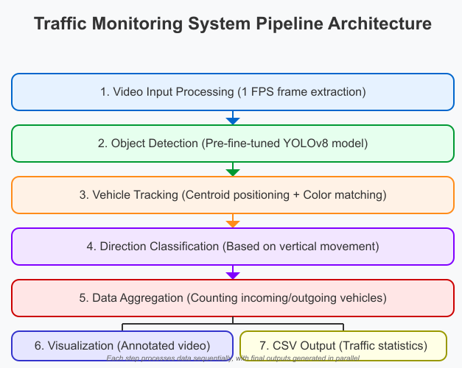
System Pipeline Architecture
2
Video Input
Object Detection
(Pre-fine-tuned YOLOv8)
Vehicle Tracking
Direction Classification
Data Aggregation
Visualization & Output Generation
IIT Kharagpur | 2025

Slide 4
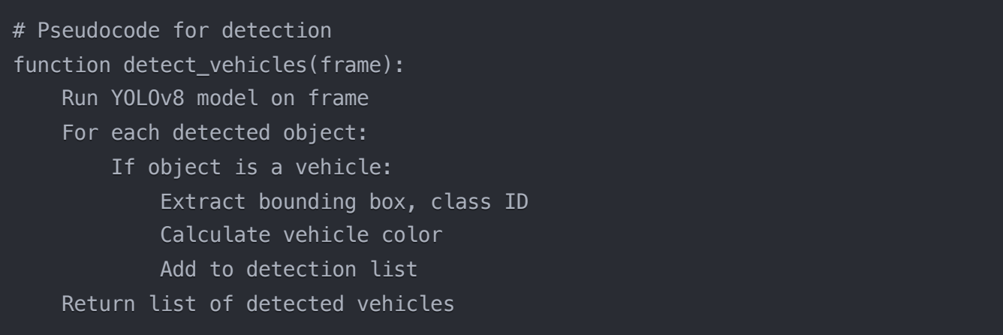
Pipeline: Vehicle Detection
3
IIT Kharagpur | 2025

Slide 5
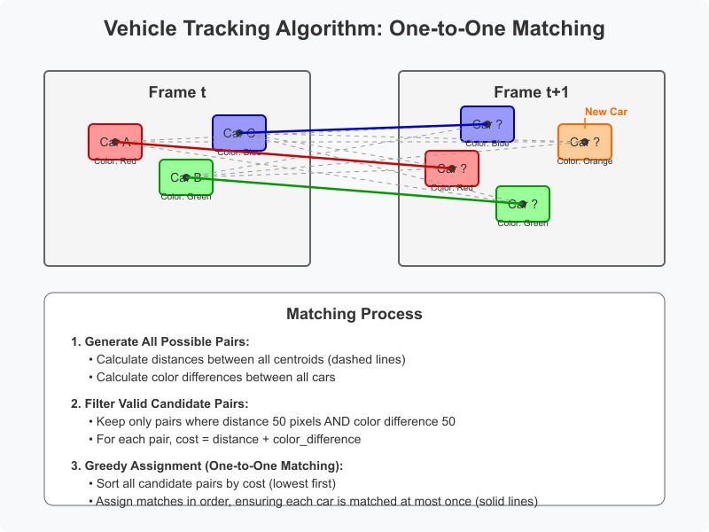
Pipeline: Vehicle Tracking Heuristics
4

Slide 6
Pipeline: Vehicle Tracking Heuristics
& Direction Classification
5
Multi-Criteria Approach:
Spatial: Euclidean distance < 50 pixels
Appearance: Color difference < 50 (RGB)
Temporal: Time difference ≤ 3 frames
Class-specific: Vehicles tracked by class ID
Direction Classification :
New Vehicles: Based on frame height (frame_height/2)
Tracked Vehicles: Based on it’s previous centroid location
IIT Kharagpur | 2025

Slide 7
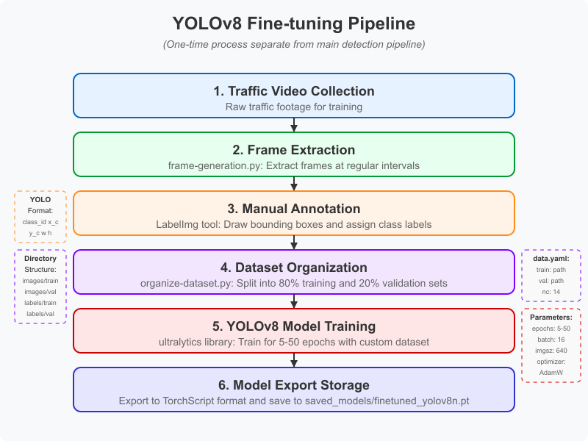
YOLOv8 finetuning Pipeline
6
Separate from main pipeline
One-time process
to create a specialized model
Uses ultralytics library for training
IIT Kharagpur | 2025

Slide 8
YOLOv8 finetuning Pipeline
7

Slide 9
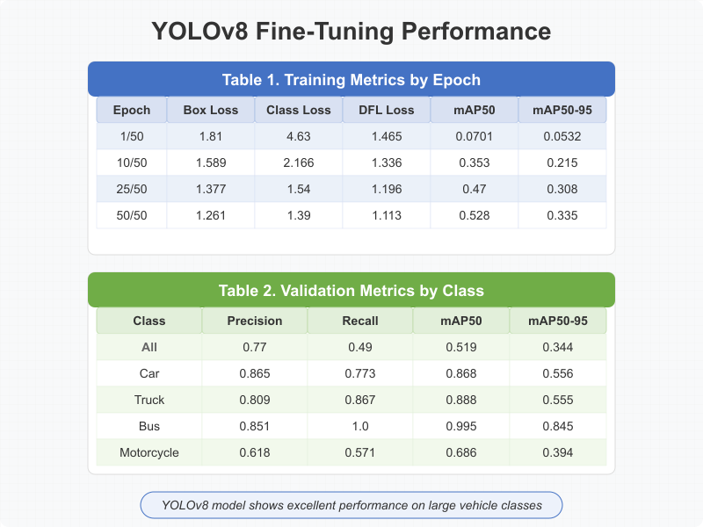
Fine-Tuning Results
8

Slide 10
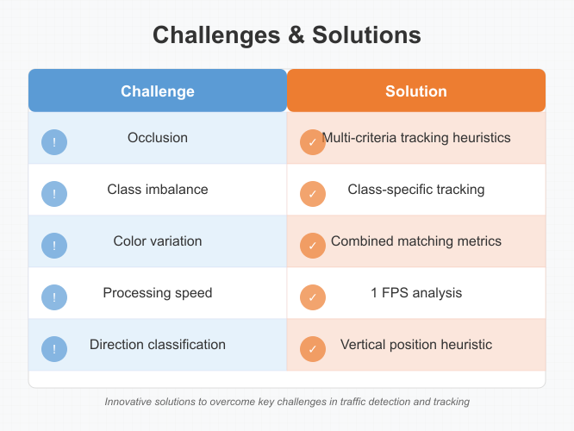
Challenges & Solutions
7

Slide 11
IIT Kharagpur | 2025
THANK YOU
Presented By : Saras Umakant Pantulwar

